Slide 1
MODULE 09: CIRCULATION/ HEMORRHAGE CONTROL
TCCC TIER 1
All Service Members
TCCC TIER 2
Combat Lifesaver
TCCC TIER 3
Combat Medic/Corpsman
TCCC TIER 4
Combat Paramedic/Provider
#TCCC-CLS-PPT-09 17 Apr 24

Slide 2




TACTICAL COMBAT CASUALTY CARE (TCCC) ROLE-BASED TRAINING SPECTRUM
ROLE 1 CARE
NONMEDICAL PERSONNEL
MEDICAL PERSONNEL
ASM
CMC
CPP
CLS
YOU ARE HERE
STANDARDIZED JOINT CURRICULUM

Slide 3
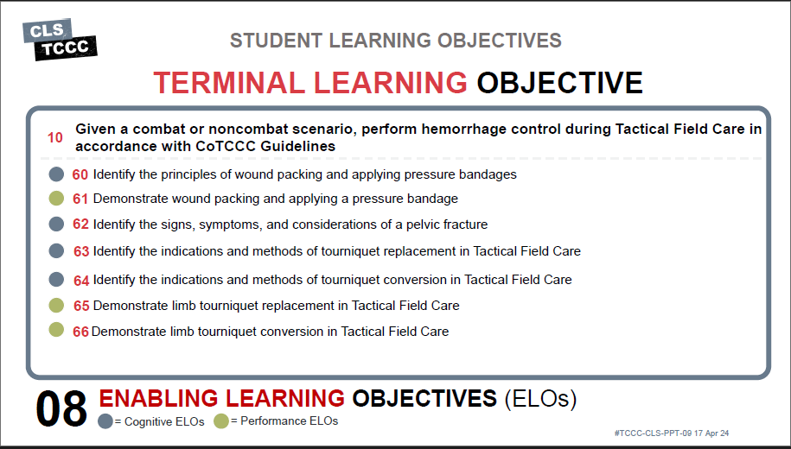
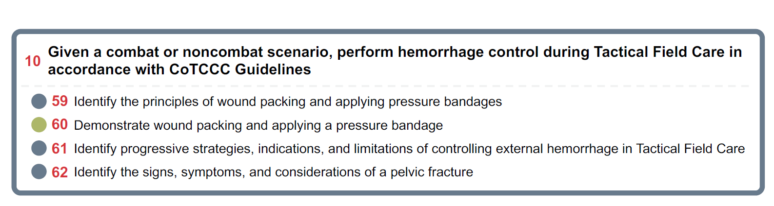






TERMINAL LEARNING OBJECTIVE
STUDENT LEARNING OBJECTIVES
₁₀ Given a combat or noncombat scenario, perform hemorrhage control during Tactical Field Care in accordance with CoTCCC Guidelines
Identify the principles of wound packing and applying pressure bandages
Demonstrate wound packing and applying a pressure bandage
Identify progressive strategies, indications, and limitations of controlling external hemorrhage in Tactical Field Care
Identify the signs, symptoms, and considerations of a pelvic fracture
4
ENABLING LEARNING OBJECTIVES (ELOs)
= Cognitive ELOs
= Performance ELOs

Slide 4


Three PHASES of TCCC
1
CARE UNDER FIRE
RETURN FIRE AND TAKE COVER
TACTICAL FIELD CARE
COVER AND CONCEALMENT
TACTICAL EVACUATION CARE
More deliberate assessment and treatment of unrecognized
life-threatening injuries
2
3
Quick decision-making:
Basic management plan:
Consider scene safety
Identify and control life- threatening bleeding
Move casualty to safety
Maintain tactical situational awareness
Triage casualties as required
Conduct MARCH PAWS
assessment
▪
Pre-evacuation procedures
Continuation of documentation
NOTE: This is covered in more advanced TCCC training!

Slide 5

MARCH PAWS
TACTICAL FIELD CARE
CIRCULATION/SHOCK
DURING LIFE-THREATENING
AFTER LIFE-THREATENING
M A R C H
MASSIVE BLEEDING #1 Priority
P
PAIN
AIRWAY
A
ANTIBIOTICS
R RESPIRATION (breathing)
C CIRCULATION
_{H} HYPOTHERMIA/ HEAD INJURIES
W
WOUNDS
S
SPLINTING
5

Slide 6


HEMORRHAGE CONTROL OVERVIEW
HEMORRHAGE CONTROL IN TACTICAL FIELD CARE
Video can be found on DeployedMedicine.com

Slide 7

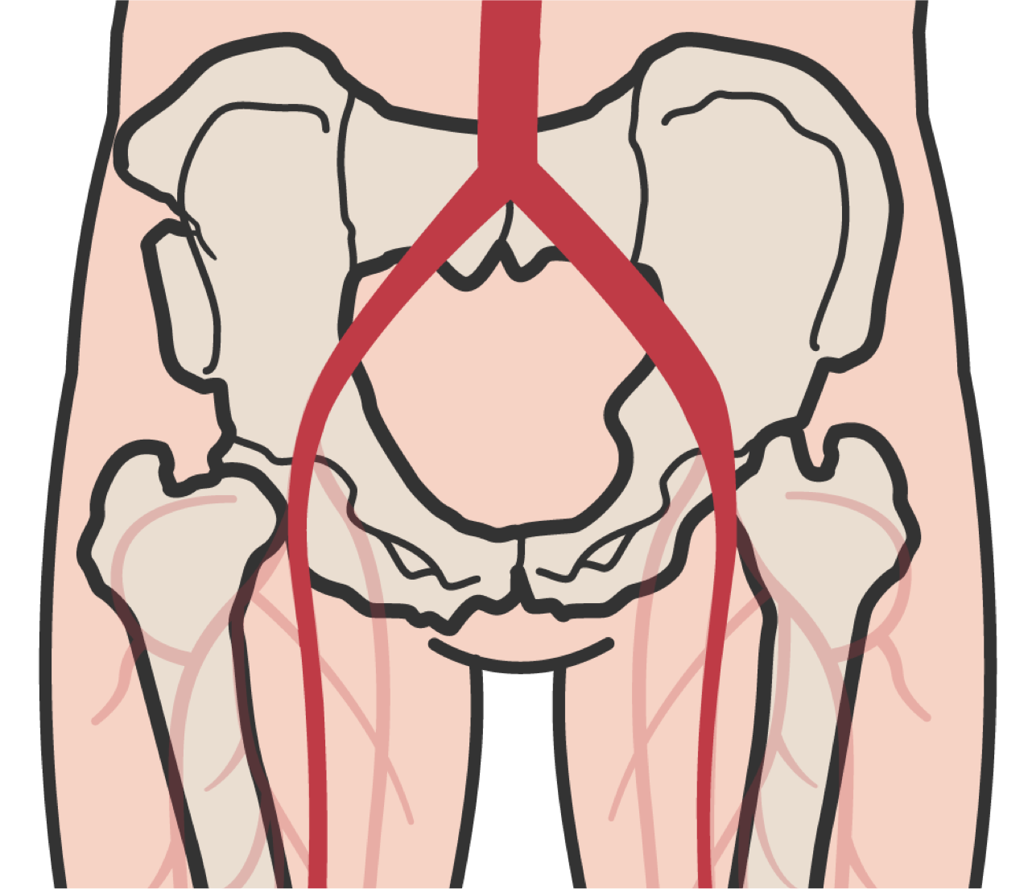

HEMORRHAGE CONTROL
PELVIC FRACTURES
Pelvic fracture may be suspected if the casualty's injuries are a result of blunt force or blast with ONE OR MORE of the following:
Physical signs suggesting a pelvic fracture:
Pelvic pain
Major lower limb amputation OR lower near amputations
Deformities, penetrating injuries, bruising near the pelvis
Pelvic instability or crepitus (crinkly or grating feeling or sound under the skin)
Unconsciousness or shock
If a pelvic fracture is suspected, the casualty WILL REQUIRE advanced evaluation by medical personnel
M A R C H

Slide 8
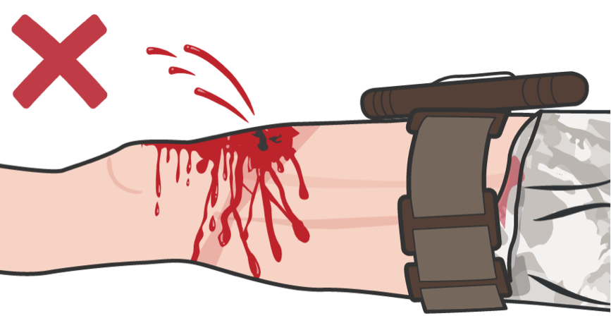
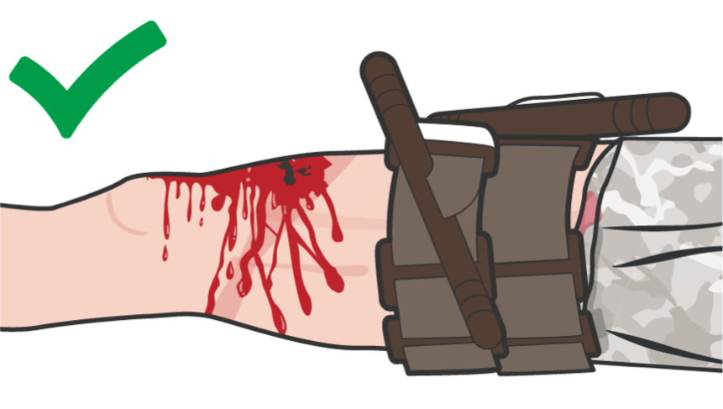
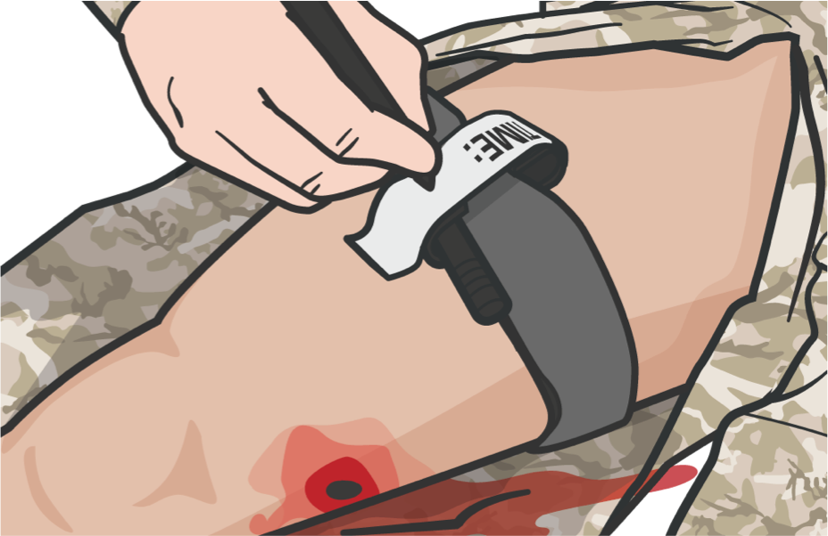
HEMORRHAGE CONTROL
REASSESSMENT
Reassess all PREVIOUS and CURRENT hemostatic dressings applied and ensure they are tight and effective
If ineffective, apply a second TQ side-by-side with the first
Reassess all PREVIOUS and CURRENT hemostatic dressings applied for effectiveness
If you placed a TQ above a casualty’s elbow, for instance, you should expect to find no pulse at the wrist below if the TQ was properly applied
M A R C H

Slide 9
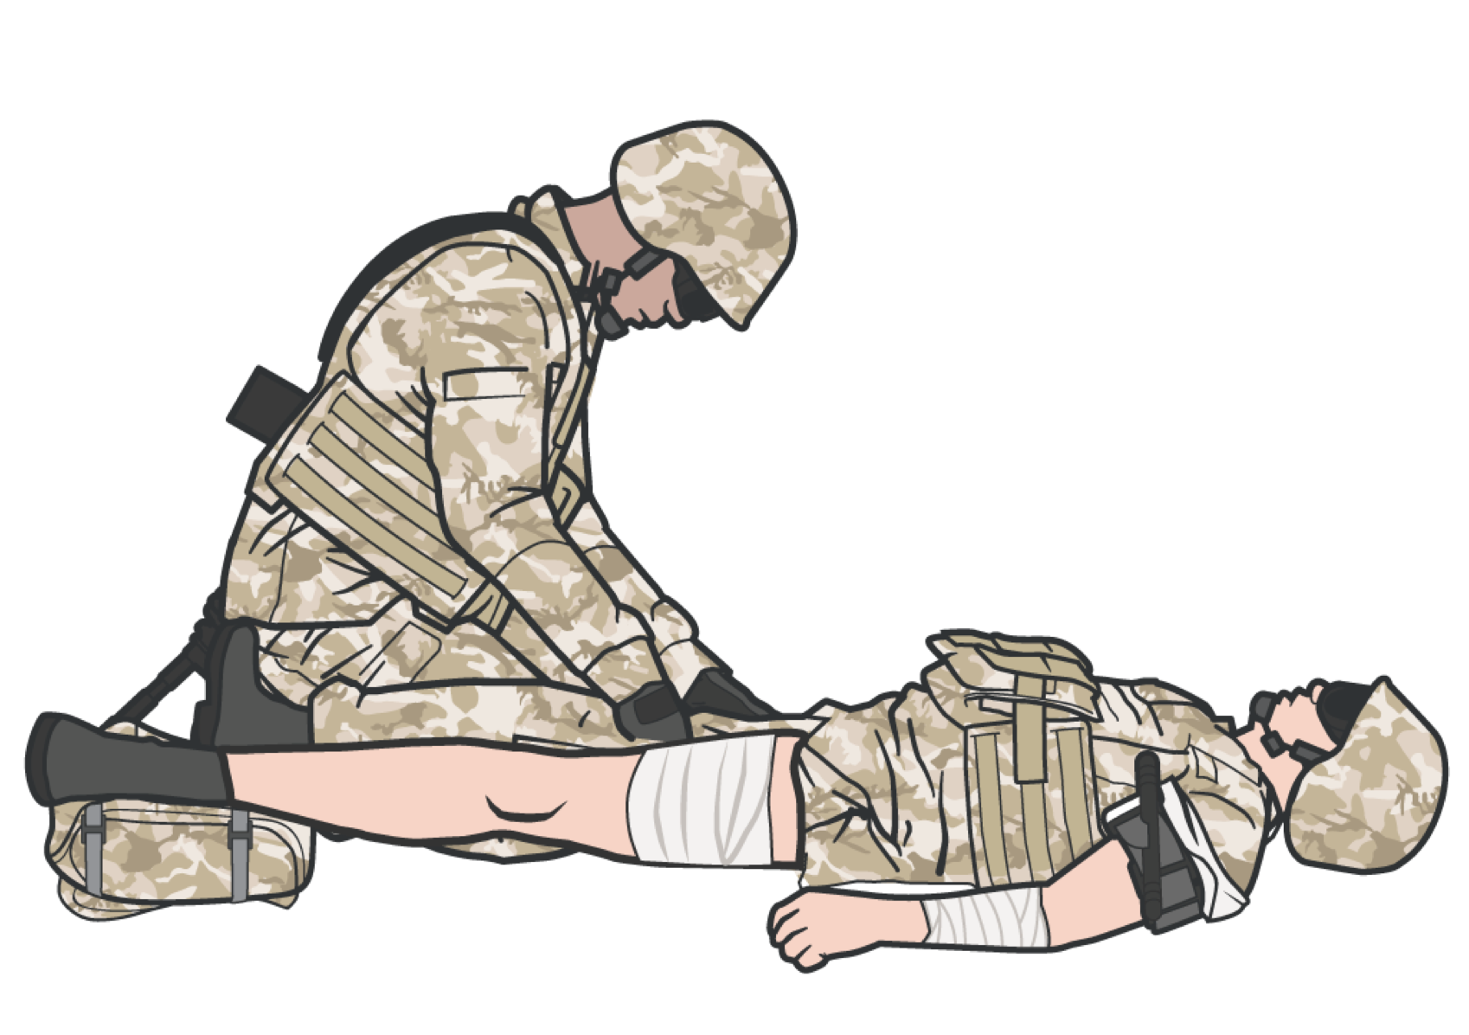
STRATEGIES AND LIMITATIONS
HEMORRHAGE CONTROL
EARLY CONTROL OF SEVERE HEMORRHAGE IS CRITICAL
CoTCCC-recommended hemostatic dressings are to be applied directly to the skin in TFC 2-3 inches above the bleeding site
Casualty’s hemorrhage control interventions must be FREQUENTLY REASSESSED to ensure continued hemorrhage control
DO NOT EVER APPLY IT AND FORGET IT!
M A R C H

Slide 10
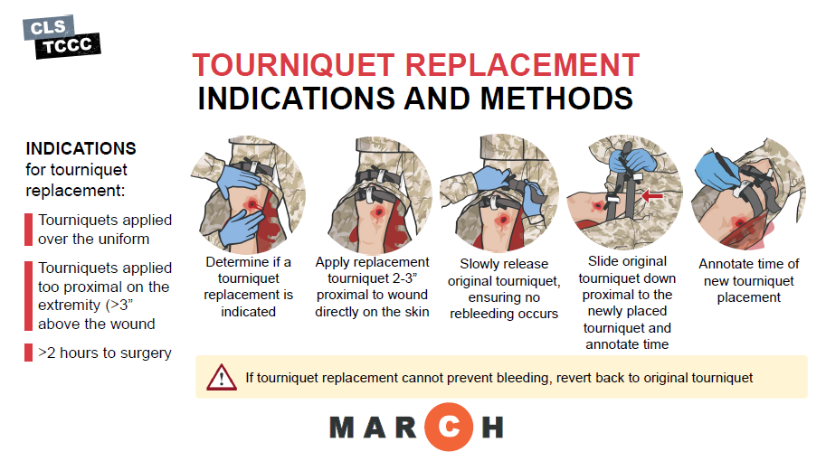

Slide 11
TOURNIQUET REPLACEMENT
HEMORRHAGE CONTROL IN TACTICAL FIELD CARE
11

Slide 12
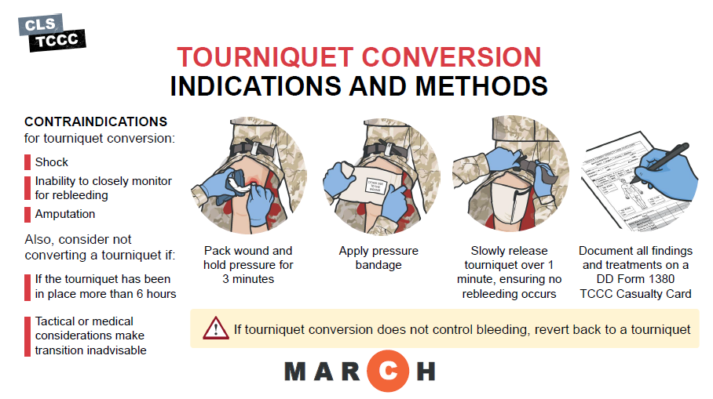

Slide 13
TOURNIQUET CONVERSION
HEMORRHAGE CONTROL IN TACTICAL FIELD CARE
13

Slide 14
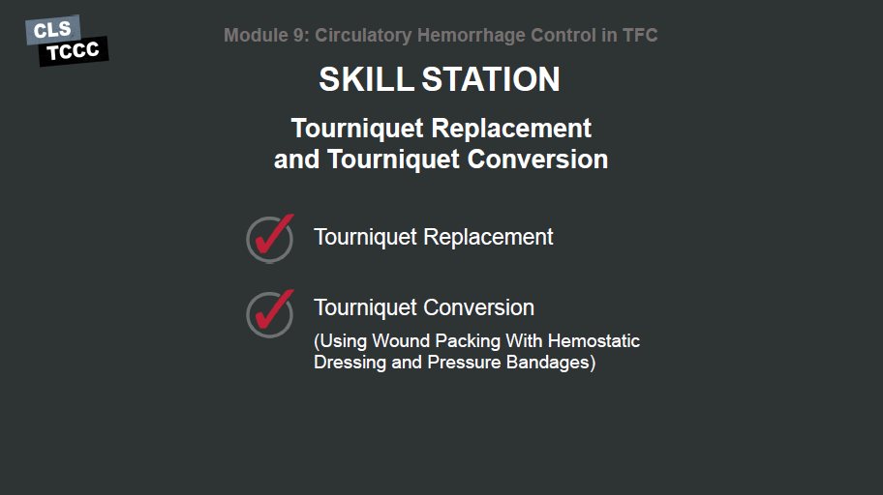

Slide 15
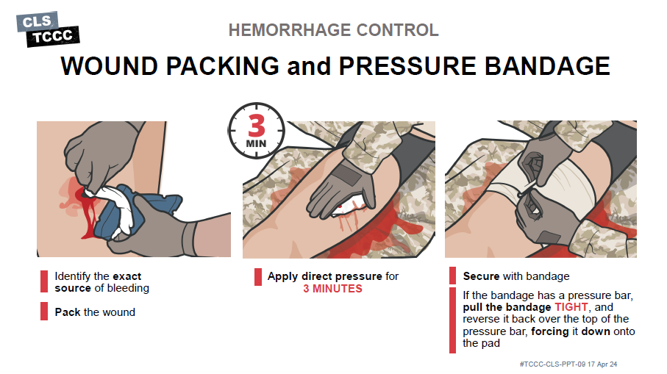

Identify the exact source of bleeding
Pack the wound
Apply direct pressure for
3 MINUTES
Secure the bandage
If the bandage has a pressure bar,
pull the bandage TIGHT, and reverse it back over the top of the pressure bar, forcing it down onto the pad
M A R C H

Slide 16

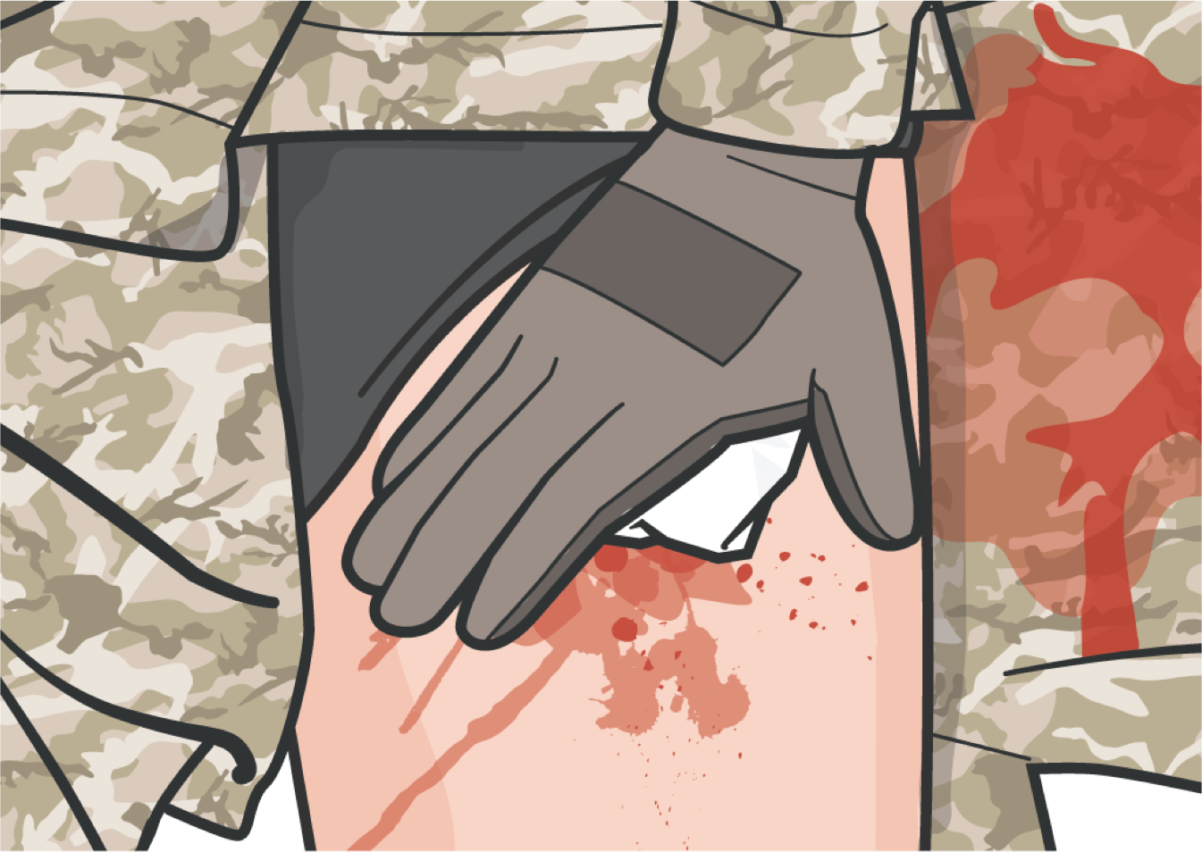
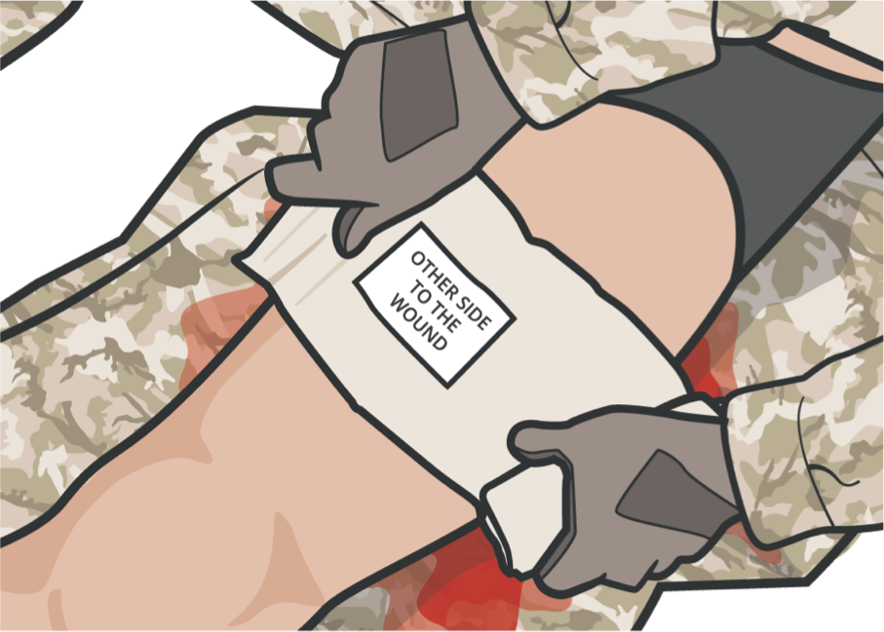

HEMORRHAGE CONTROL
WOUND PACKING
Identify the exact source of bleeding and APPLY direct pressure as a temporary measure UNTIL gauze is placed
Pack the wound maintaining CONSTANT direct pressure at the source of bleeding within 90 SECONDS to be effective
Once you are sure the bleeding has
stopped, apply a pressure bandage
HOLD direct pressure on the gauze over the wound for at least 3 MINUTES (this is necessary, even with the active ingredient in hemostatic dressings)
When packing a large wound, more than one hemostatic gauze and/or additional gauze may be needed
Carefully observe to determine if bleeding has been controlled
M A R C H
#TCCC-CLS-PPT-09 17Apr 24
11

Slide 17
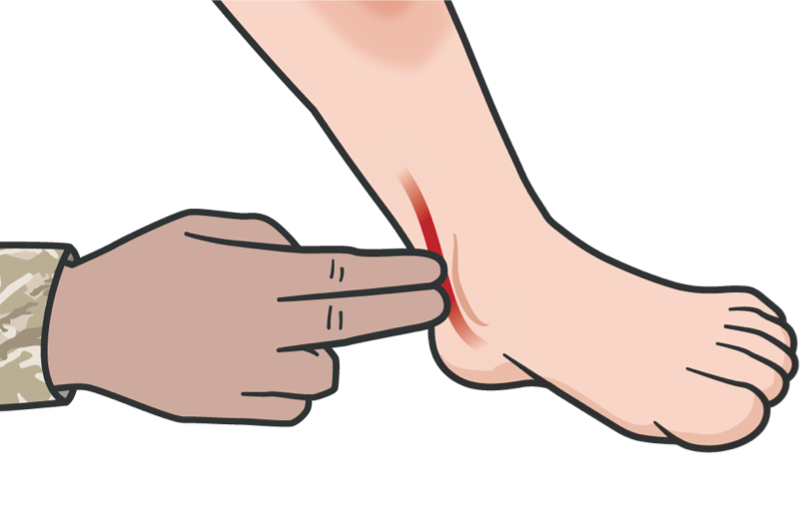
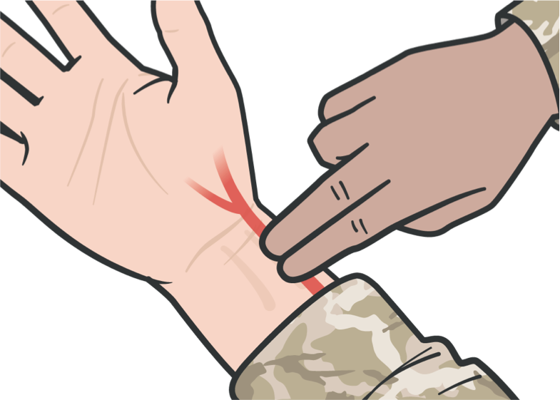
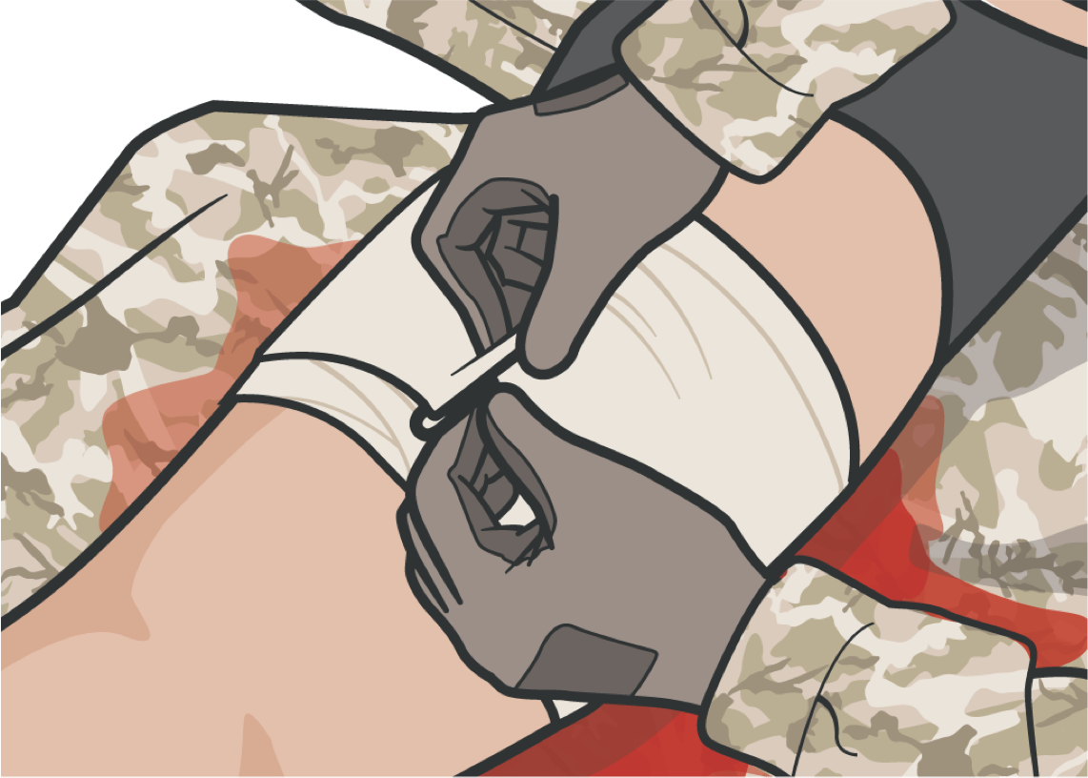
HEMORRHAGE CONTROL
PRESSURE BANDAGE REASSESSMENT
Key Points:
Check for circulation BELOW the pressure bandage by feeling for distal pulse (a pulse below the bandage)
If the skin BELOW the pressure bandage becomes cool to the touch, bluish, or numb, or if the pulse below the pressure dressing is no longer present, the pressure bandage may be too tight
If circulation is BLOCKED or STOPPED, loosen
and retie the bandage
Dressings and bandages should be reassessed and checked routinely and EVERY TIME a casualty is moved
17

Slide 18
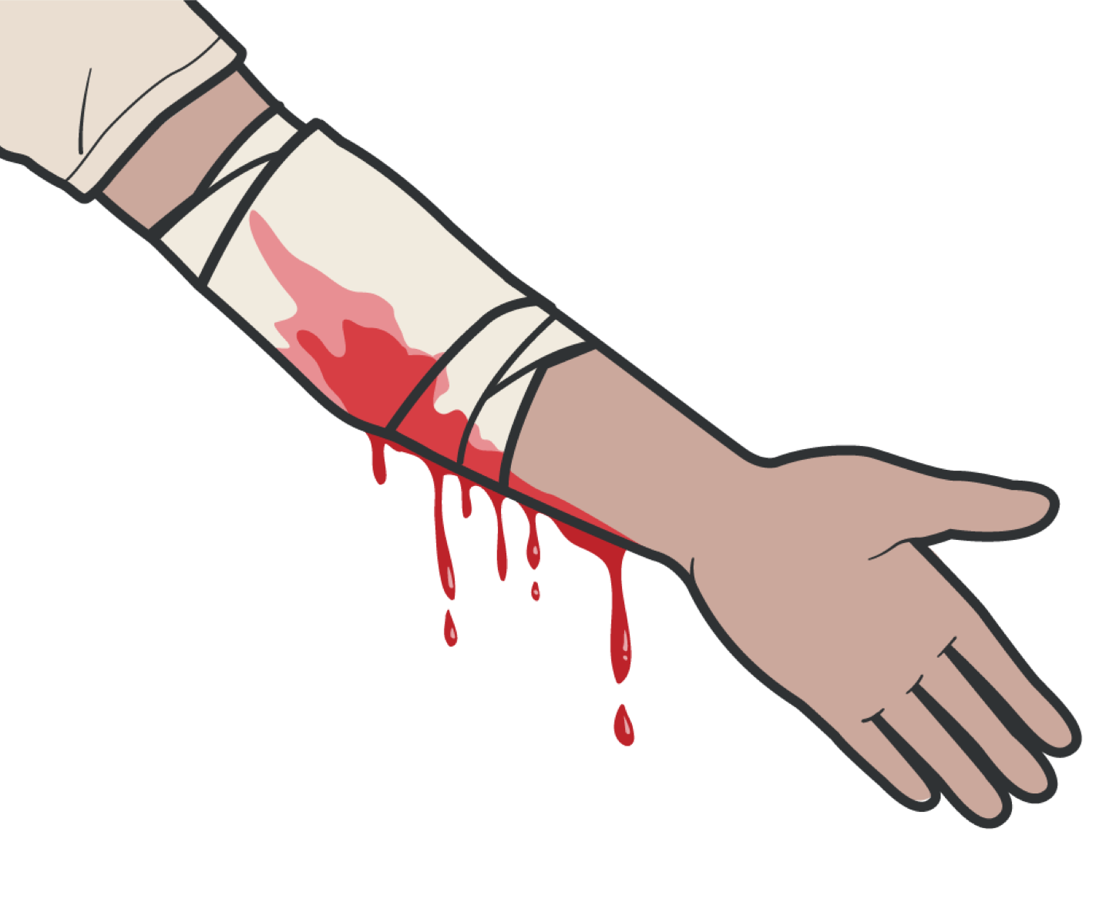
HEMORRHAGE CONTROL
IF THE PRESSURE BANDAGE IS INEFFECTIVE
If the pressure bandage or hemostatic dressing is ineffective, APPLY a hemostatic dressing 2-3 inches above the bleeding site
If the pressure bandage is ineffective AND/OR blood soaked, REPLACE pressure dressing with hemostatic dressing
Pack the wound, maintaining CONSTANT direct pressure at the source of bleeding within 90 SECONDS to be effective
M A R C H
18

Slide 19
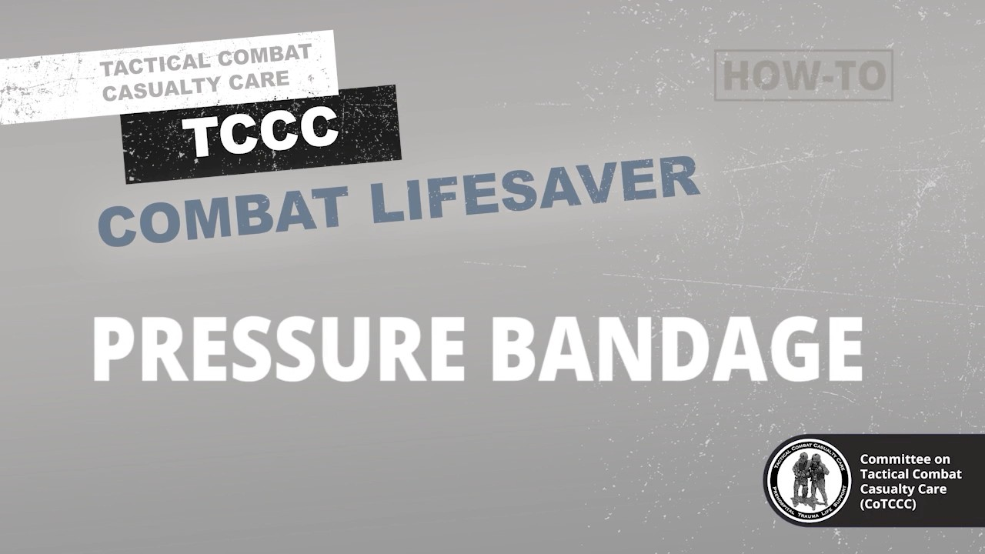
PRESSURE BANDAGE
HEMORRHAGE CONTROL IN TACTICAL FIELD CARE
Video can be found on DeployedMedicine.com
19

Slide 20
SKILL STATION
Circulation/Hemorrhage Control (Skills)
Wound Packing With Hemostatic Dressing and Pressure Bandage
20

Slide 21
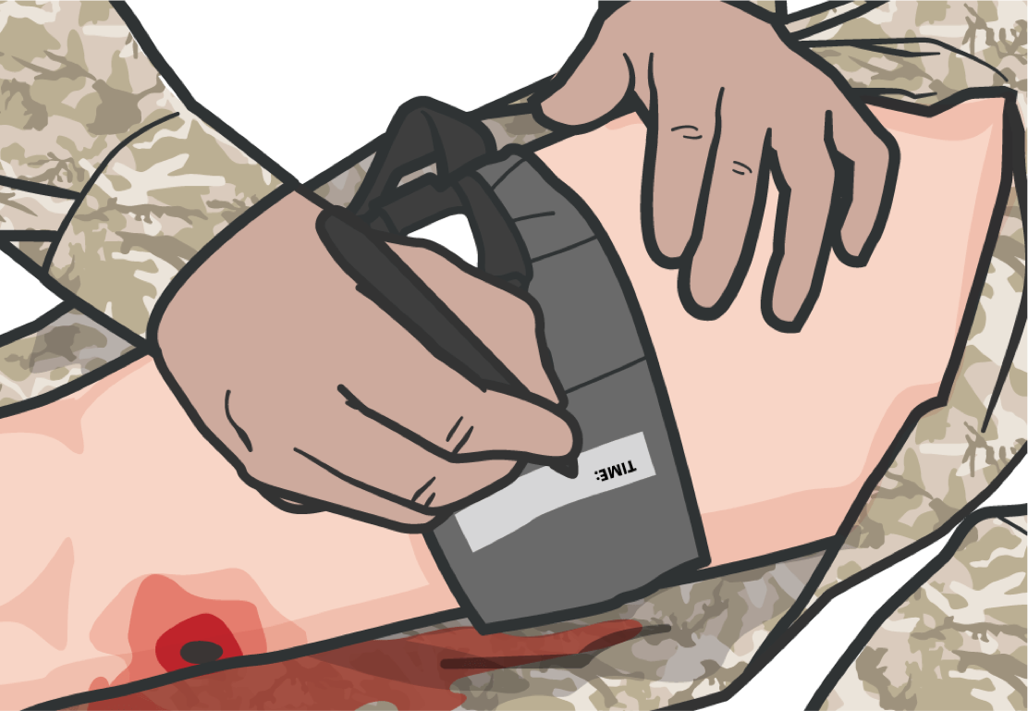
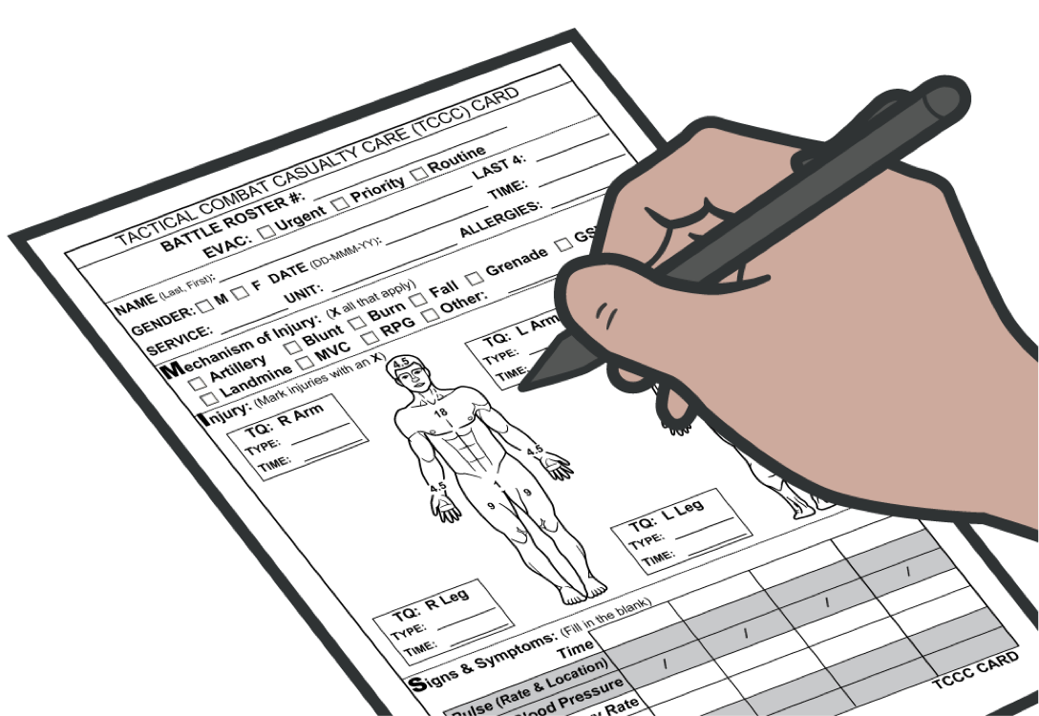
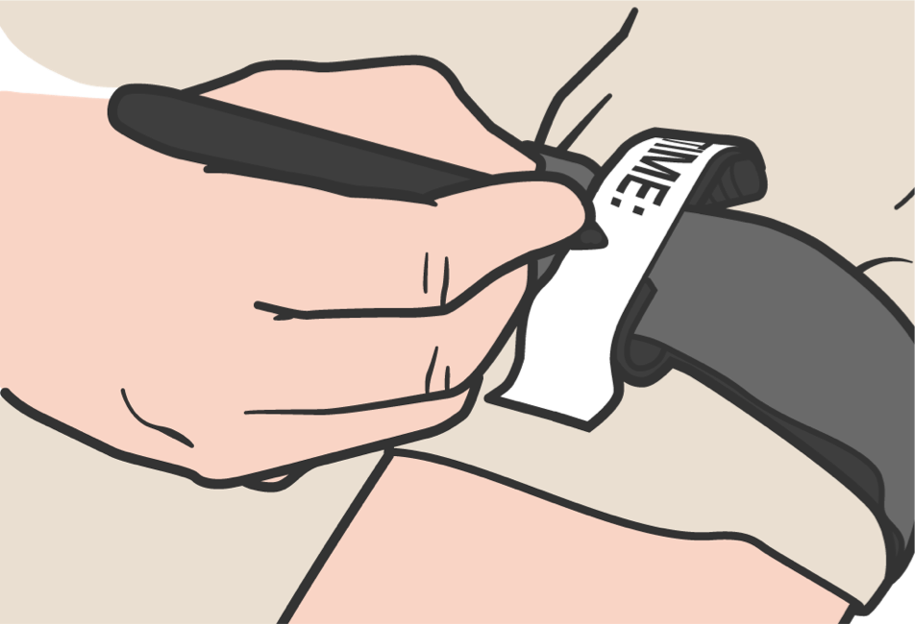

HEMORRHAGE CONTROL
SUMMARY
If not already done, clearly mark ALL TQs with
the time of TQ application and document that on the
DD Form 1380 TCCC Casualty Card
Check for radial pulse
Assess for shock
21

Slide 22
CHECK ON LEARNING
During Circulation in the MARCH PAWS sequence, what interventions should be reassessed?
What are the signs and symptoms of a pelvic fracture?
22

Slide 23
ANY QUESTIONS?
23

